Slide 1

Anomaly Detection in IoT Network using Machine Learning
School of Computer Science and Engineering
Department of Computer Science and Engineering
Submitted By: Kushagra Singh
2427030043
Supervised By: Dr. Praneet Saurabh

Slide 2
Outline
Introduction
Literature Review
Problem Statement
Proposed Solution
Objectives
Results

Slide 3
Introduction
The rapid growth of Internet of Things (IoT) devices has significantly increased network traffic and expanded exposure to cyber threats. Due to limited security and computational capabilities, IoT devices are highly vulnerable to attacks. Therefore, detecting anomalous behavior in IoT network traffic has become essential to ensure network security and reliability.

Slide 4
Introduction
Why Machine Learning?
Traditional signature-based systems fail for new attacks
IoT traffic is high-dimensional and dynamic
ML can learn complex patterns
Enables real-time anomaly detection

Slide 5
Literature Review (Traditional Approaches)
Approach | Description | Advantages | Limitations
Signature-Based Detection | Detects attacks by matching network traffic with predefined attack signatures | High accuracy for known attacks | Cannot detect zero-day attacks; requires constant updates
Rule-Based Systems | Uses manually defined rules to identify suspicious behavior | Easy to interpret and implement | Poor scalability; not adaptive
Statistical Thresholding | Flags anomalies based on deviation from predefined thresholds | Simple and computationally light | Assumes normal distribution; high false positives
Specification-Based Detection | Defines acceptable behavior and flags violations | Good for controlled environments | Difficult to define accurate specifications for dynamic IoT networks

Slide 6
Literature Review (Machine Learning Approaches)
Algorithm | Description | Strengths | Limitations
Random Forest | Ensemble of multiple decision trees | High accuracy; robust to noise; handles high-dimensional data | Moderate computational cost
Support Vector Machine (SVM) | Finds optimal hyperplane for classification | Effective in complex decision boundaries | Computationally expensive for large datasets
K-Nearest Neighbors (KNN) | Classifies based on nearest data points | Simple and effective | Slow prediction time; high memory usage
Logistic Regression | Linear classification model | Fast and scalable | Limited for nonlinear patterns
Decision Tree | Tree-based classification model | Easy to interpret; fast | Prone to overfitting
Naive Bayes | Probabilistic classifier based on Bayes theorem | Very fast and lightweight | Assumes feature independence

Slide 7
Problem Statement
“How can machine learning be used to detect anomalies in IoT network data and evaluate the performance of different models efficiently through a user-friendly system?”

Slide 8
Objectives
Pre-process IoT datasets.
Implement multiple ML models.
Develop a web-based system
Allow dataset upload and model selection
Analyse model performance
Identify misclassified instances

Slide 9
Proposed Methodology (Flowchart)
Develop a web-based system
Use pre-trained ML models
User uploads dataset and selects model
System performs prediction
Displays results and analysis.

Slide 10
Proposed Methodology
1. Data
RT_IoT2022 Dataset
123,117 network traffic records
85 features
Multi-class attack categories

Slide 11
Proposed Methodology
2. Data Preprocessing
Removal of missing values
Label encoding of categorical features
Feature scaling using StandardScaler
Train-test split (70%-30%)

Slide 12
Proposed Methodology
3. Machine Learning Models Used (for Training and Testing)
Random Forest
Support Vector Machine
K-Nearest Neighbors
Logistic Regression
Decision Tree
Naive Bayes

Slide 13
Proposed Methodology
4. Evaluation Metrics
Accuracy
Precision
Recall
F1-Score (2*[precision*recall]/[precision + recall])
Confusion Matrix

Slide 14
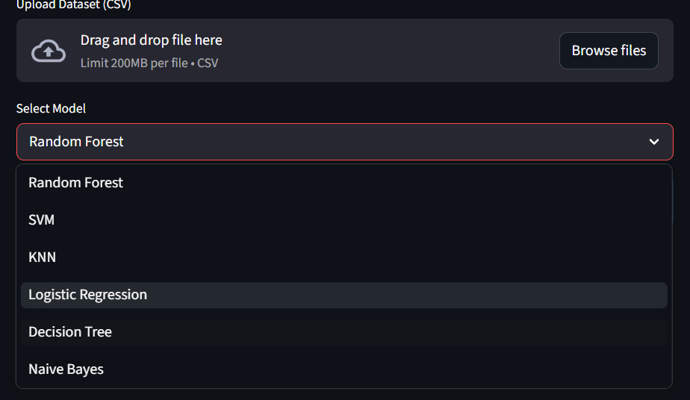
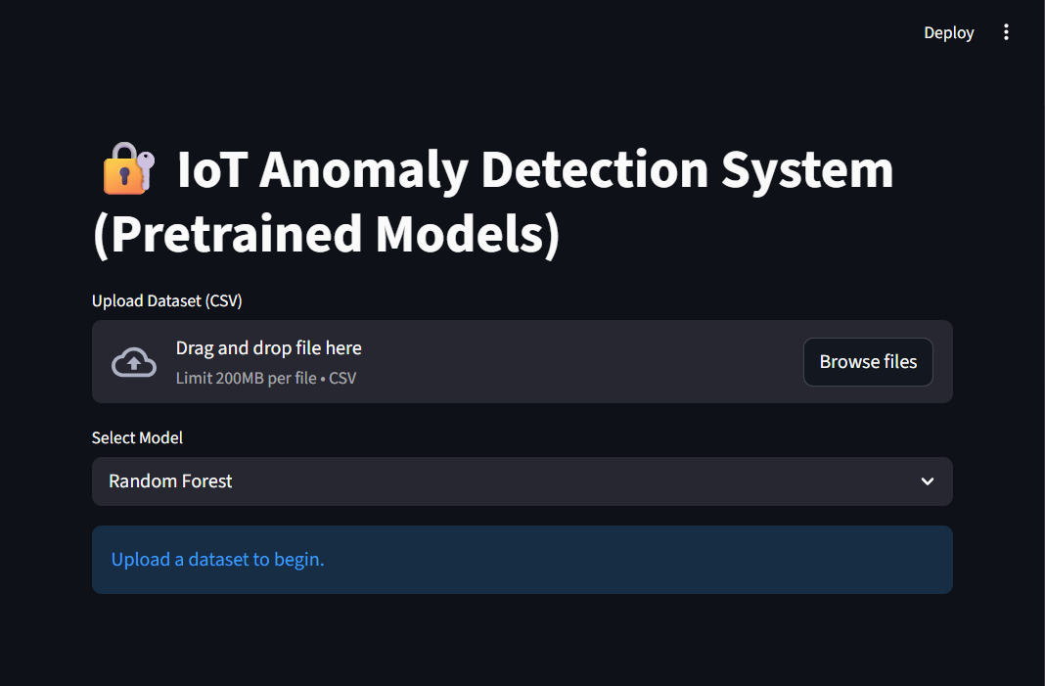
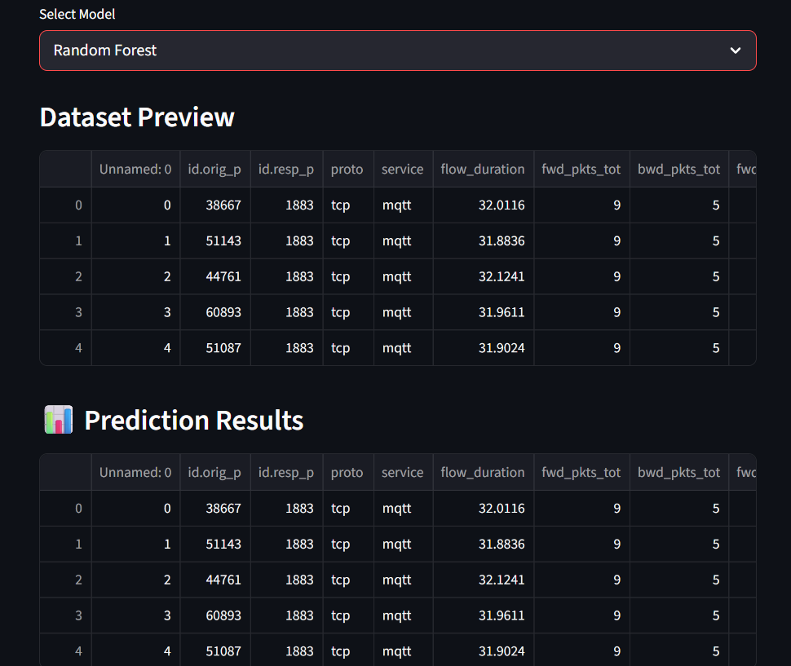
Result

Slide 15
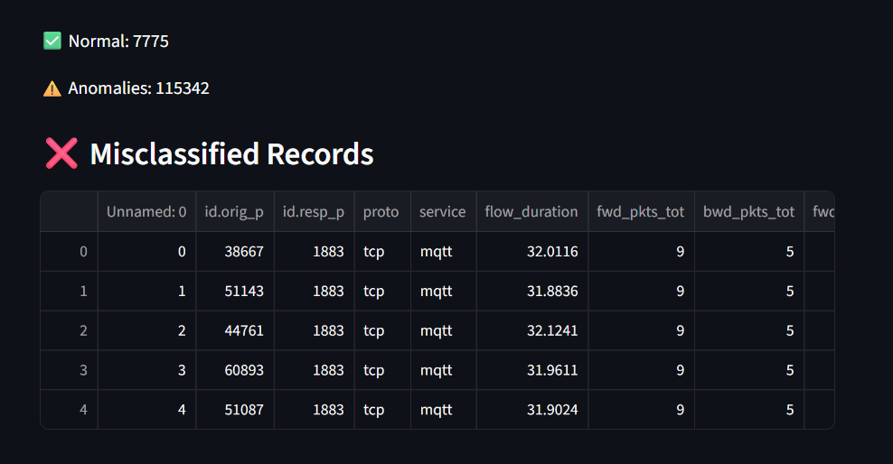
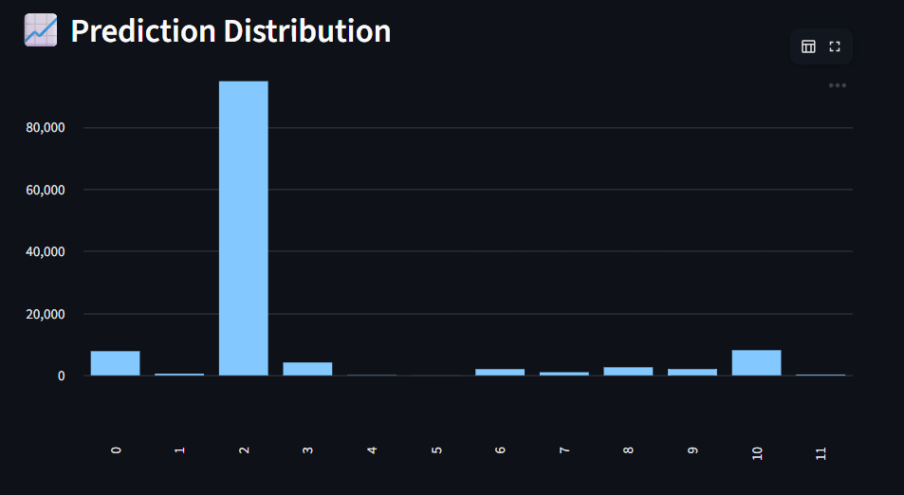
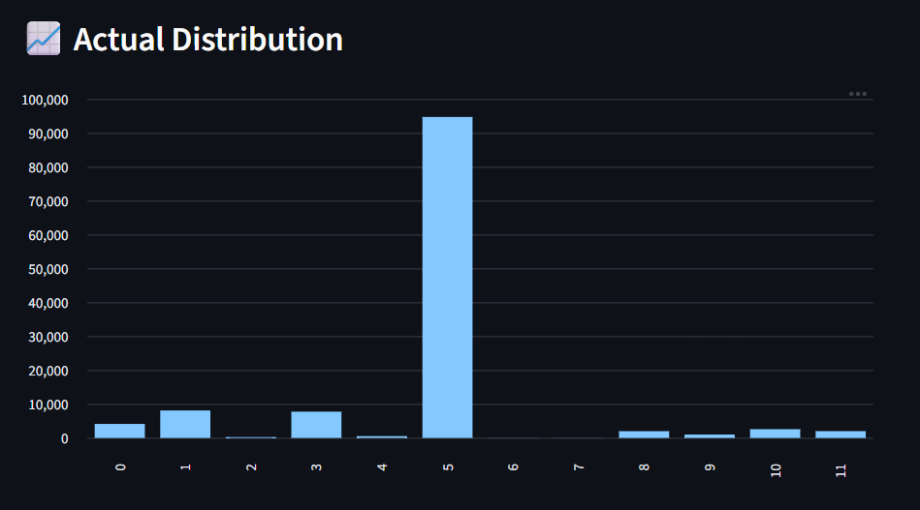

Result

Slide 16
Outcomes
Developed a functional Anomaly Detection System
Integrated Machine Learning with Web Interface
Enabled Real Time Dataset Analysis

Slide 17
Future Work
Add Multi Dataset support
Integrate Feature Importance Analysis

Slide 18
References
Moustafa, N., & Slay, J. (2022). RT_IoT2022: A Real-Time IoT Network Intrusion
Detection Dataset.
Ahmed, M., Mahmood, A. N., & Hu, J. (2016). “A Survey of Network Anomaly Detection
Techniques.” Journal of Network and Computer Applications.
Scikit-learn Documentation.
IEEE Xplore Digital Library – Research articles on IoT intrusion detection systems.
Streamlit Documentation

Slide 19
Thank You

